Slide 1

School of Computer Science and Engineering
Department of Computer Science and Engineering
AI-Powered Elderly Healthcare & Safety Assistant-
Submitted By:
Aditya Chauhan
2427030248
Supervised By:
Dr. Ajit Noonia

Slide 2
Outline
Introduction
Literature Review
Problem Statement
Proposed Solution
Objectives

Slide 3
Introduction
The elderly population is rapidly increasing globally, leading to growing healthcare and safety challenges.
Common issues include missed medications, lack of vital monitoring, fall risks, delayed emergency responses, and social isolation.
Most current healthcare apps focus on single aspects (like reminders or vitals) rather than a holistic system.

Slide 4
Introduction
Our project aims to build an AI-powered mobile + wearable solution for continuous elderly care.
It integrates Wireless Sensor Networks (WSN), Machine Learning (ML), and IoT to provide proactive and preventive health management.
The goal is to create a smart, safe, and user-friendly ecosystem for elderly healthcare.

Slide 5
Literature Review
Existing solutions such as Google Fit and Apple Health focus on vitals but lack emergency or mental well-being integration.
Some IoT-based prototypes address fall detection but not medication or emotional health tracking.

Slide 6
Literature Review
Research in Wireless Sensor Networks (WSN) shows promise for body-centric monitoring, but power and reliability remain challenges.
Machine Learning has been successfully used for health anomaly detection, but not widely implemented in elderly-specific systems.

Slide 7
Literature Review
Studies show that multimodal healthcare systems (sensors + AI + caregiver dashboards) can reduce risks by 40%.
However, there’s a lack of unified frameworks integrating WSN + ML + VANET for elderly care and emergency safety.

Slide 8
Problem Statement
Elderly individuals lack an integrated system for continuous health monitoring, emergency response, and mental well-being support, leading to delayed care and safety risks.

Slide 9
Proposed Solution
AI-Powered Elderly Healthcare & Safety Assistant
Combines wearable sensors (for vitals & fall detection) with a mobile app for real-time monitoring.
Provides AI-driven reminders, anomaly alerts, and SOS-based emergency communication.
Features a voice-first interface for accessibility and caregiver dashboards for monitoring.

Slide 10
Proposed Solution
Sensor Layer (WSN): Wearables + IoT devices (BP, HR, glucose, fall sensors).
Communication Layer: Bluetooth/Wi-Fi → Mobile App → Cloud DB.
ML Layer: Health risk prediction, anomaly detection, mood analysis.
Application Layer: Elderly app + Caregiver dashboard + Doctor/hospital integration.

Slide 11
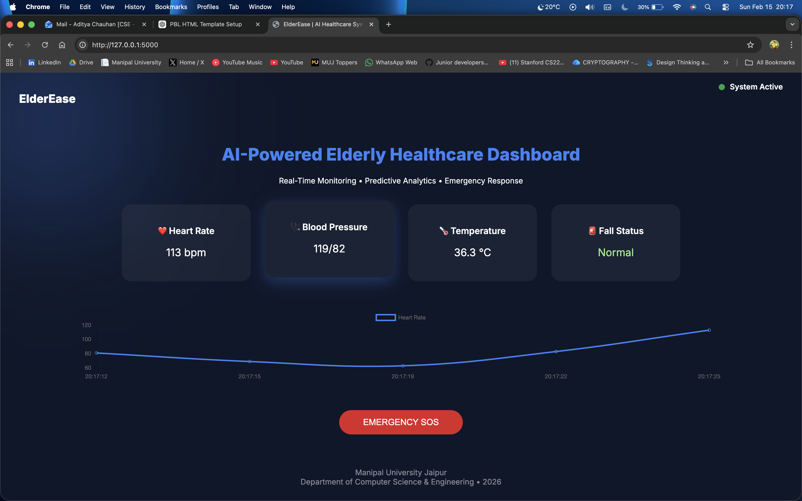
Result

Slide 12
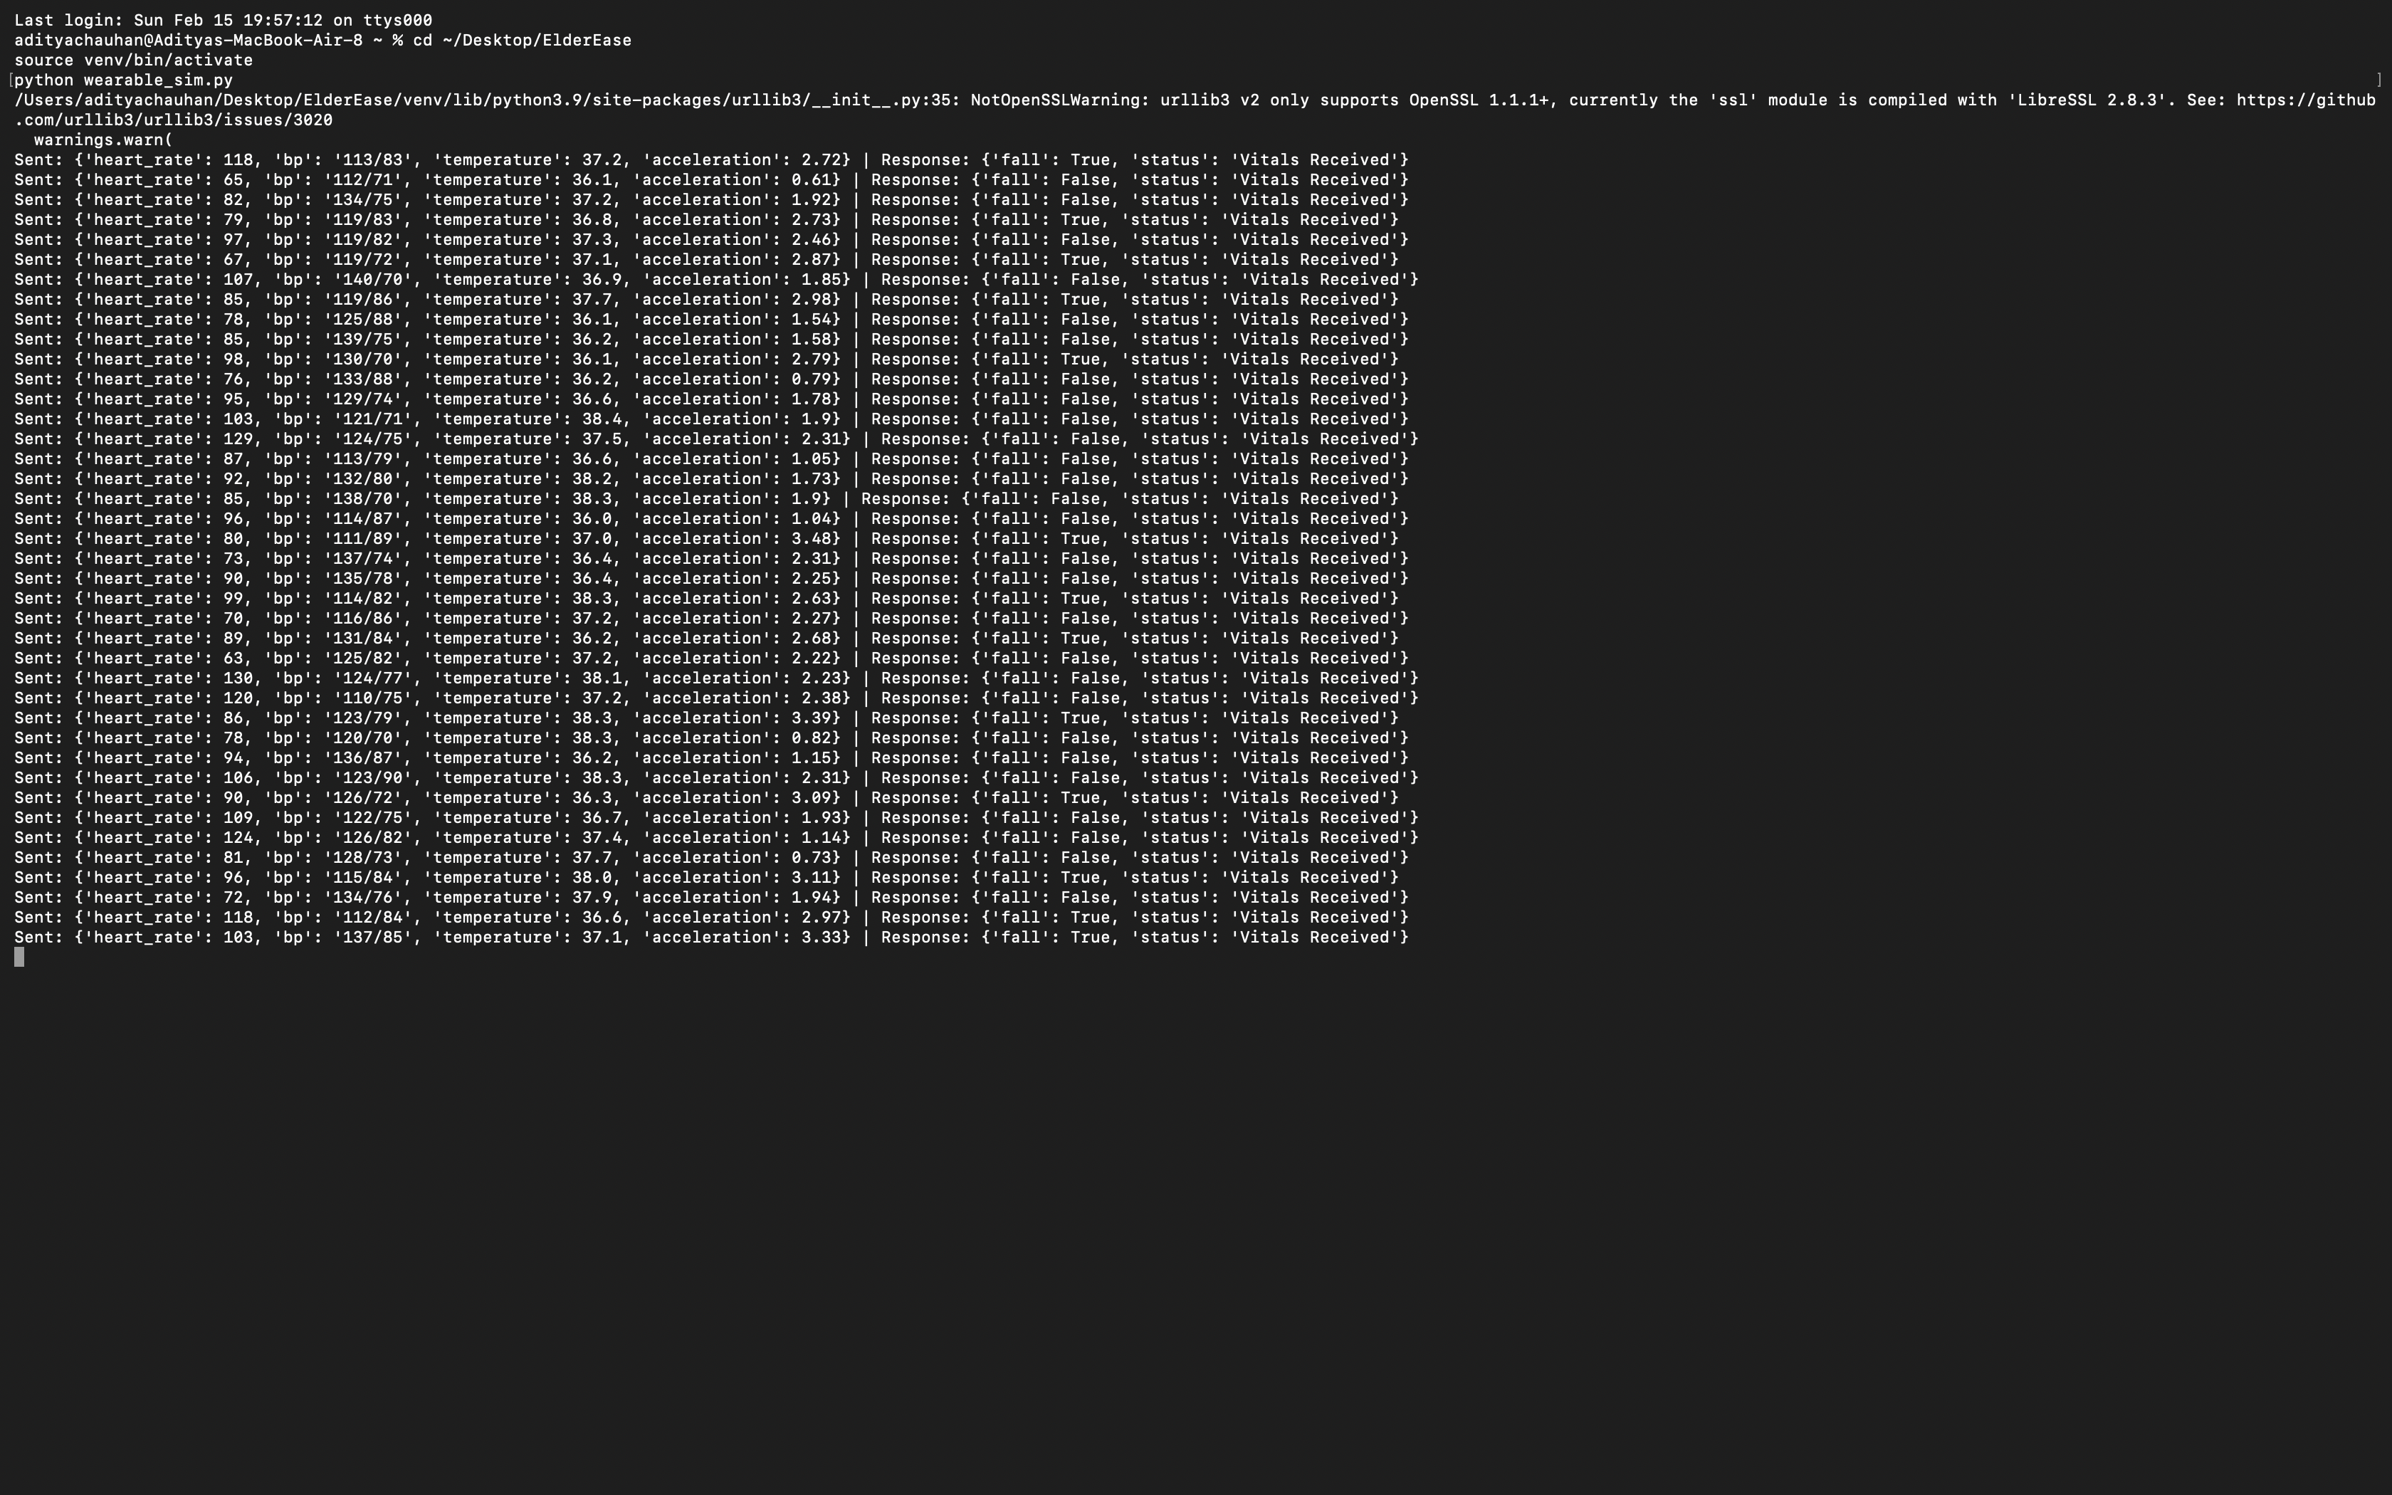

Slide 13
Outcomes
Functional System Development
Designed and developed a working prototype of an AI-powered elderly healthcare monitoring system.
Integrated simulated wearable sensor data with a real-time backend server.
Developed a live caregiver dashboard for continuous monitoring of patient vitals.
Real-Time Health Monitoring
Implemented continuous tracking of key health parameters including heart rate, blood pressure, and body temperature.
Visualized health data using dynamic charts for clear and immediate interpretation.
Fall Detection and Emergency Support
Developed threshold-based fall detection logic using motion data.
Implemented an emergency SOS mechanism to notify caregivers instantly.
Established a basic framework for real-time alert communication.
System Architecture Implementation
Successfully designed and implemented a layered architecture:
Sensor Layer → Communication Layer → Backend Processing → Dashboard Interface
Created a modular and scalable system foundation suitable for further expansion.

Slide 14
Future Prospects
Advanced Artificial Intelligence Integration
Replace rule-based fall detection with advanced machine learning models such as Random Forest or LSTM for time-series prediction.
Train models using real elderly healthcare datasets to improve predictive accuracy and reliability.
Real Hardware Integration
Integrate microcontroller-based wearable devices such as ESP32 or Arduino.
Connect real health sensors including heart rate, SpO₂, temperature, and motion sensors.
Implement edge processing for faster anomaly detection.
Smartwatch and API Integration
Integrate commercial wearable platforms such as Apple HealthKit, Google Fit, and Samsung Health.
Enable real-time synchronization between wearable devices and cloud-based systems.
Telemedicine and Smart Healthcare Ecosystem
Develop a dedicated doctor dashboard for remote patient monitoring.
Integrate secure cloud-based health record management.
Expand toward a comprehensive smart elderly-care ecosystem connecting caregivers, hospitals, and emergency services.

Slide 15
Objectives
To design a wearable + mobile-based elderly healthcare and safety system.
To apply Machine Learning for predictive health analytics and fall detection.
To implement real-time emergency alert mechanisms using IoT and VANET principles.
To enhance usability through a voice-first, multilingual interface for elderly users.

Slide 16
References
WHO Global Health and Aging Report, 2024.
IEEE Paper: “Body Sensor Networks for Healthcare Monitoring,” 2023.
ACM Digital Library: “ML-based Fall Detection Systems,” 2022.
ResearchGate: “VANET Applications in Smart Healthcare,” 2023.
National Institute on Aging – Health Data Trends, 2024.

Slide 17
Thank You

